Slide 1

DISASTER MANAGEMENT SYSTEM
BY :
RA2211030010089 - Rashmika S
RA2211030010091 - Shreya De
RA2211030010122 - Chaarvi Ayineni

Slide 2

ABSTRACT :-
The "Community Disaster Management System" is a web-based platform transforming local emergency responses by integrating Resource Inventory, Incident Reporting, Communication Hub, Mapping, and Volunteer Management tools. Utilizing advanced technologies, it expedites resource allocation, delivers timely alerts, and facilitates real-time communication among stakeholders. Users input crucial data for seamless coordination, while automated alerts ensure prompt notifications based on incident severity and location. The platform serves as a centralized hub for collaboration, fostering effective response efforts. Its Mapping component provides spatial insights, enhancing decision-making and situational awareness. Overall, it empowers communities to manage disasters efficiently, optimize resource utilization, and strengthen resilience.

Slide 3
PROBLEM STATEMENT:-
The "Disaster Management System" project aims to empower local communities with efficient tools for effective emergency responses. It addresses challenges such as limited coordination, resource scarcity, delayed reporting, communication barriers, and the need for community engagement. By providing a centralized platform integrating key components like Resource Inventory, Incident Reporting, Communication Hub, Mapping, and Volunteer Management, the system enhances coordination, resource allocation, and communication among stakeholders. Through seamless interaction and advanced features, it fosters collaboration, resilience, and preparedness, enabling communities to mitigate the impacts of disasters effectively.

Slide 4
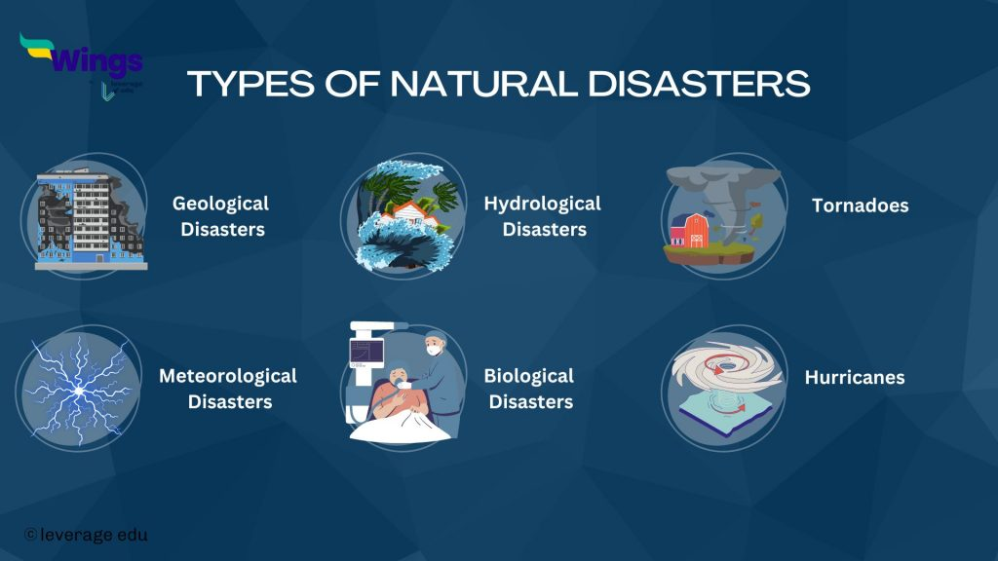

Slide 5
AIM :-
The aim of the Disaster Management System project is to empower local communities with efficient tools and resources to orchestrate swift and effective responses during emergencies. By providing a centralized platform for communication, resource allocation, and incident reporting, the project seeks to enhance coordination, resilience, and preparedness at the grassroots level.

Slide 6
SCOPE :-
Development of a web-based platform integrating key components such as Resource Inventory, Incident Reporting and Alerts, Communication Hub, Mapping and Visualization, and Volunteer Management.Implementation of advanced technologies including web development tools, backend frameworks, databases, mapping libraries, and messaging APIs.
Facilitation of swift resource allocation, timely incident reporting, real-time communication, and efficient volunteer management.
Integration of mapping and visualization features for enhanced decision-making and situational awareness.
Seamless interaction among emergency responders, volunteers, local authorities, and residents.

Slide 7
BENEFICIARIES :-
Community Members: Access to timely information, resources, and assistance during emergencies.
Emergency Responders: Improved coordination, communication, and resource allocation.
Local Authorities: Enhanced situational awareness and decision-making capabilities.
Volunteers: Opportunities for active participation and contribution to community resilience.
Organizations: Improved efficiency and effectiveness in disaster response efforts.

Slide 8
ADVANTAGES :-
Enhanced coordination and communication during emergencies.
Swift and effective resource allocation and incident reporting.
Improved situational awareness through mapping and visualization.
Increased community resilience and preparedness.
Seamless interaction among stakeholders.

Slide 9
DISADVANTAGES :-
Initial setup and implementation costs.
Dependence on technology, potential for system failures.
User training and adoption challenges.
Privacy and security concerns regarding data handling.
Potential for misinformation or misuse of the platform.

Slide 10
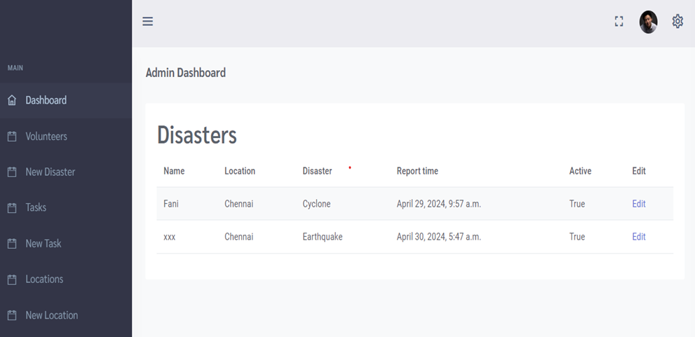
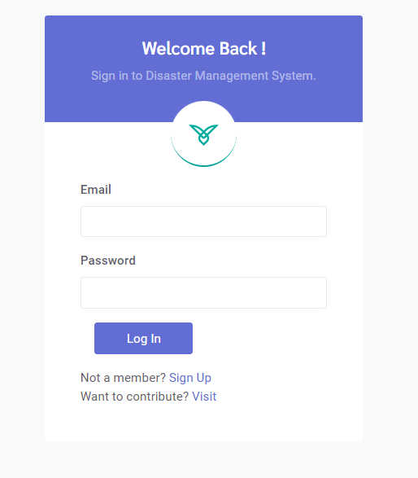
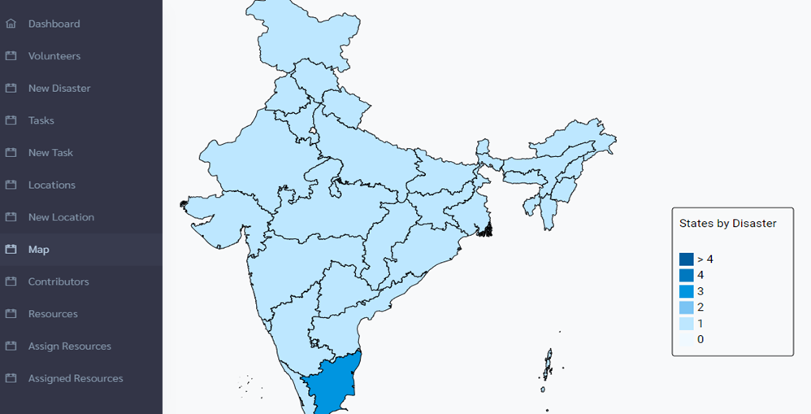
RESULTS:-

Slide 11

Thank you !

